Slide 1
Agentic AI Health Symptom Checker
CAPSTONE PROJECT
Presented By:- ADITYA RAJ
College Name :- Government Engineering College ,Lakhisarai
Department :- Computer Science & Engineering with (Artificial Intelligent)

Slide 2
OUTLINE
Problem Statement
Technology used
Wow factor
End users
Result
Conclusion
Git-hub Link
Future scope
IBM Certifications

Slide 3
Problem Statement
An Agentic AI Health Symptom Checker helps users understand their health conditions by analyzing symptoms and providing probable causes, preventive advice, and care recommendations. It retrieves verified medical data, symptom databases, and guidelines from trusted sources like WHO, government health portals, and medical journals. Users can input symptoms in natural language such as “I have a sore throat and fever,” and the agent provides possible conditions, urgency level, home remedies, and when to consult a doctor. It supports multi-language interaction and avoids self-diagnosis risks by offering educational and referral-based suggestions. This AI-driven assistant promotes early detection, reduces misinformation, and empowers users to take informed health actions.

Slide 4
Technology used
IBM cloud lite services
Natural Language Processing (NLP)
Retrieval Augmented Generation (RAG)
IBM Granite model
IBM Cloud Object Storage
IBM Language Translator

Slide 5
IBM cloud services used
IBM Cloud Watsonx AI Studio
IBM Cloud Watsonx AI runtime
IBM Cloud Agent Lab
IBM Granite foundation model
IBM Cloud Object Storage
IBM Language Translator

Slide 6
Wow factors
Multilingual Understanding – Accepts symptoms in multiple languages and even mixed- language sentences.
Trusted Medical Data Sources – Uses WHO, CDC, and verified medical databases to ensure accuracy.
Symptom Clustering & Matching – Groups symptoms to suggest possible conditions with confidence scores.
Urgency Detection – Classifies cases as Self-care, Doctor visit, or Emergency.
Preventive Health Tips – Gives lifestyle and prevention advice alongside symptom results.
Voice & Chat Interaction – Works via voice input, chatbots, and messaging platforms.
Agentic Behavior – Auto-updates with latest medical guidelines and prompts follow-ups.
Privacy-First – End-to-end encrypted, no personal data stored without consent.
Adaptive Recommendations – Adjusts suggestions based on location, climate, and outbreaks.
IBM-Powered Reliability – Built on IBM Granite + IBM Cloud Lite for high security and scalability.

Slide 7
End users
General Public – Anyone wanting quick, reliable health guidance.
Rural & Remote Populations – People with limited access to healthcare facilities.
Elderly Individuals – Seniors needing simple, voice-assisted health checks.
Parents & Guardians – For monitoring children’s health symptoms.
Chronic Disease Patients – To track symptoms and receive preventive tips.
Travelers & Expats – For quick medical guidance abroad in multiple languages.
Students & Working Professionals – For fast symptom checks during busy schedules.
Telemedicine Users – For pre-consultation symptom analysis.
Pharmacy Customers – For over-the-counter guidance before purchase.
Caregivers & Social Workers – To assist vulnerable populations with basic health advice.

Slide 8
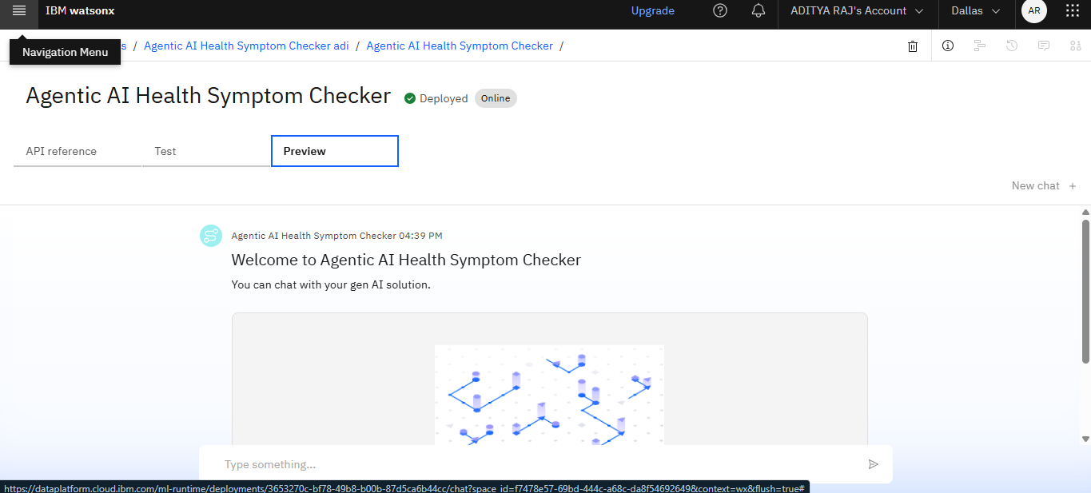
Results

Slide 9
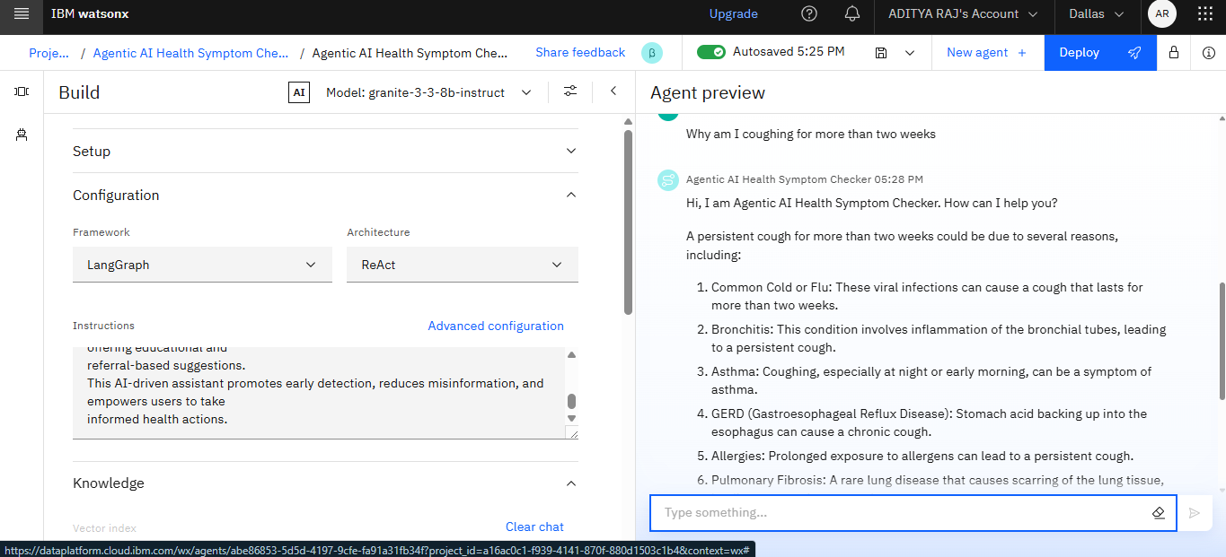
Results

Slide 10
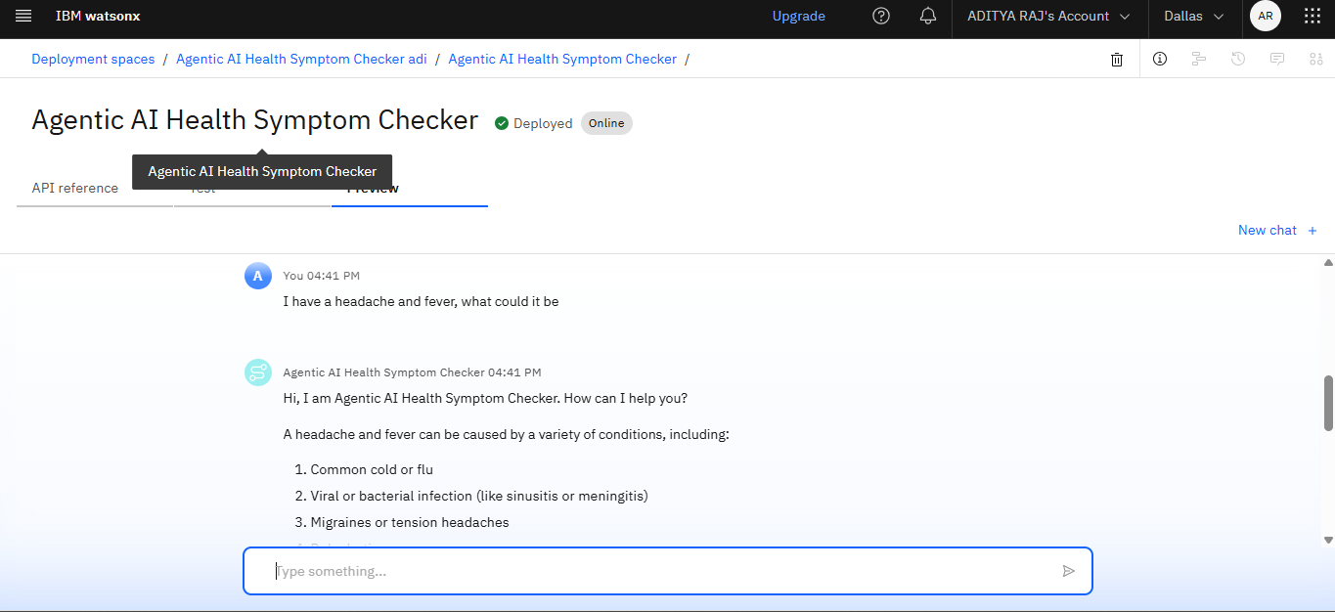
Results

Slide 11
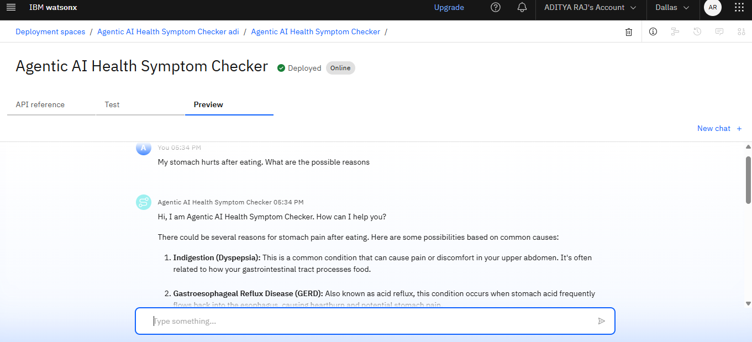
Results
Deployed AI Agent

Slide 12
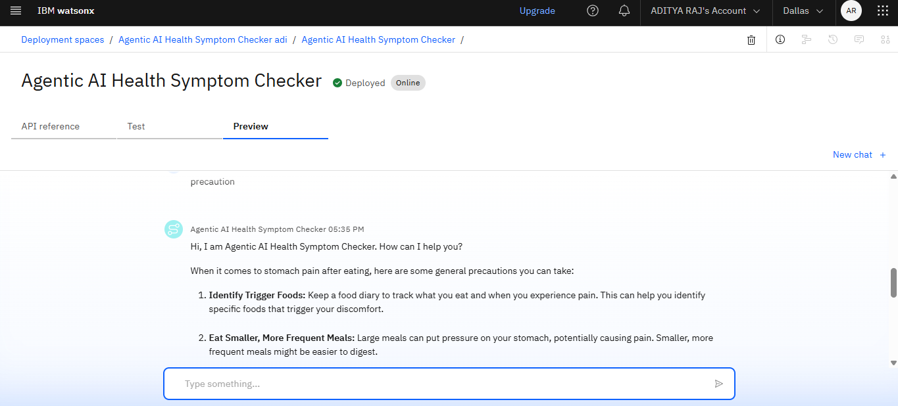

Slide 13
Conclusion
The Agentic AI Health Symptom Checker is a transformative digital health tool designed to bridge the gap between individuals and reliable healthcare information. By combining natural language processing, trusted medical databases, and multi-language support, it empowers users to understand their symptoms, take preventive measures, and make informed decisions about seeking professional care. Unlike traditional symptom checkers, its agentic capabilities allow it to actively guide users toward accurate resources, reduce misinformation, and promote early detection of potential health issues. This AI-powered solution has the potential to improve health literacy, reduce healthcare burdens, and make primary health guidance more accessible, personalized, and safe for people worldwide.

Slide 14
Future scope
Integration with Wearables – Connect with smartwatches, fitness bands, and IoT devices for real-time health data.
Advanced Predictive Analytics – Use AI to forecast potential health risks before symptoms appear.
Telemedicine Integration – Directly connect users with doctors via video or chat consultations.
Voice-Based Interaction – Enable hands-free symptom reporting for elderly and differently-abled users.
Personalized Health Recommendations – Tailor advice based on user history, lifestyle, and genetic data.
Multilingual & Regional Support – Expand to cover more languages and local dialects for inclusivity.
Mental Health Assistance – Incorporate stress, anxiety, and depression symptom tracking with guided help.
Emergency Response Integration – Auto-alert family or emergency services for critical health conditions.
Offline Mode – Allow symptom checking in low or no-internet areas using cached medical data.
Global Health Data Contribution – Share anonymized insights to help public health research and policy-making.

Slide 15
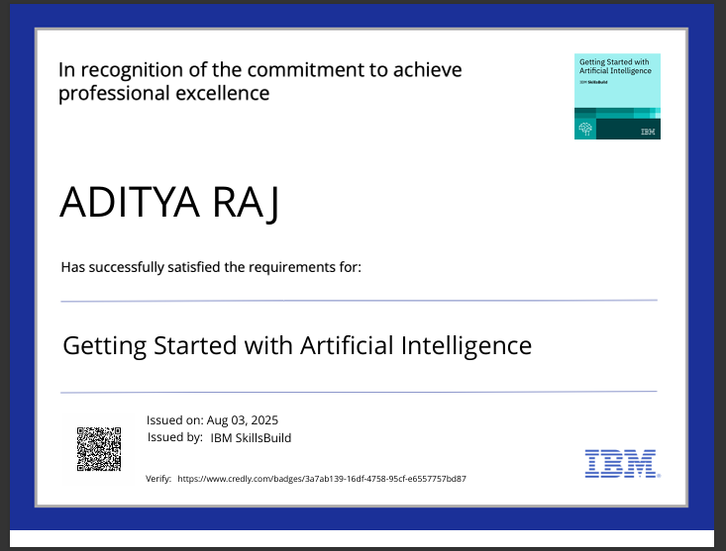
IBM Certifications
G

Slide 16


Slide 17
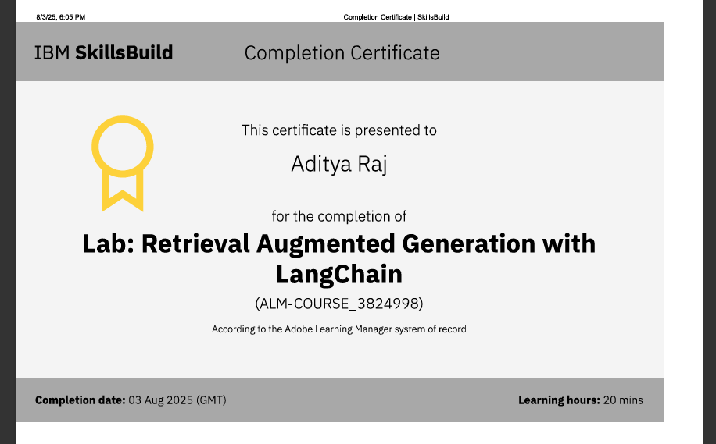
RAG LAB certificate

Slide 18
GitHub Link
Git hub lik : https://github.com/theaditya0810/Agentic-AI-Health-Symptom-Checker-

Slide 19
THANK YOU

